Slide 1

CAREPATH – HEALTHCARE SYSTEM DISEASE DETECTION (HSDD)
Innovative technology to enhance medical diagnosis accuracy
Group 1: Veezish Ahmad, Jessica Morcos, and Barbod Salehinoparvar
Notes:
---

Slide 2

SYSTEM GOALS
AI-Assisted Disease Detection
  CarePath uses AI to provide preliminary detection of diseases, aiding early diagnosis and treatment.
Secure Data Management
  The system ensures secure storage and retrieval of patient data to protect privacy and integrity.
Regulatory Compliance
  CarePath maintains compliance with healthcare regulations like HIPAA and PHIPA to ensure legal standards.
User-Friendly Interface
  The platform delivers an intuitive interface designed for patients, doctors, and administrators' ease of use.
Notes:
The primary goals of CarePath include: providing AI-assisted preliminary disease detection, ensuring secure storage and retrieval of patient data, maintaining compliance with healthcare regulations such as HIPAA and PHIPA, and delivering a user-friendly interface for patients, doctors, and administrators. These objectives collectively aim to enhance healthcare efficiency, improve patient outcomes, and uphold data integrity.

Slide 3
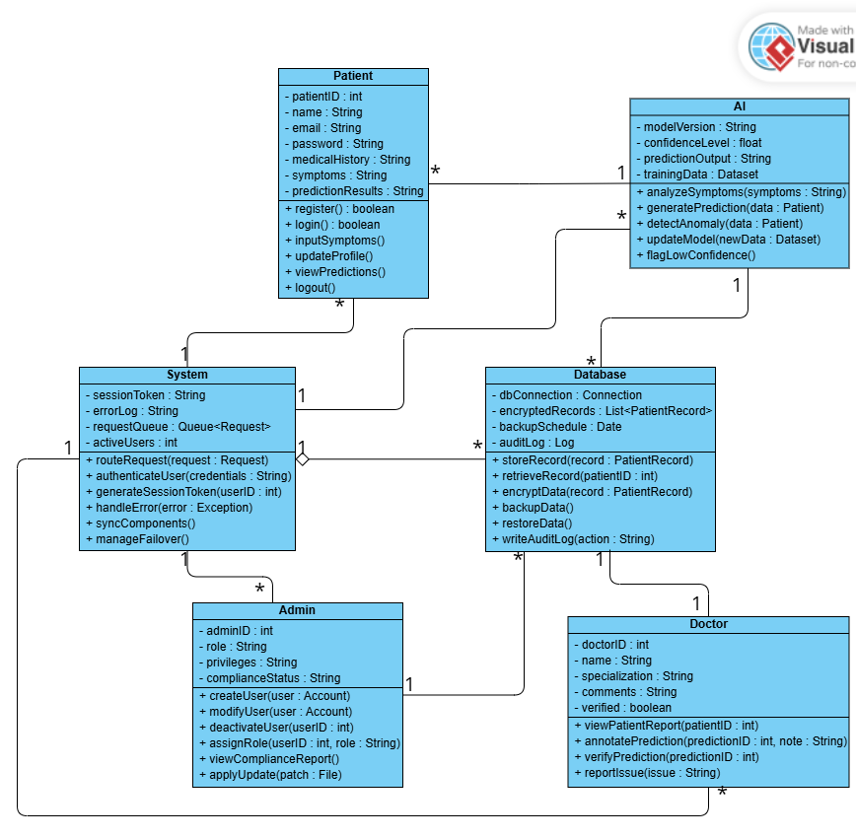
INITIAL CLASS DIAGRAM
Basic Structure Overview
  The diagram presented a basic framework focusing on abstract user classes and their minimal interactions.
Limited Relationships
  Relationships between classes were limited, reflecting an early stage of system modeling without complex associations.
Missing Detailed Components
  The diagram lacked detailed controllers and value objects needed to support design patterns implementation.
Notes:
The initial class diagram featured a basic structure with abstract user classes and limited relationships. It provided a starting point for modeling system entities but lacked detailed controllers and value objects necessary for implementing design patterns.

Slide 4
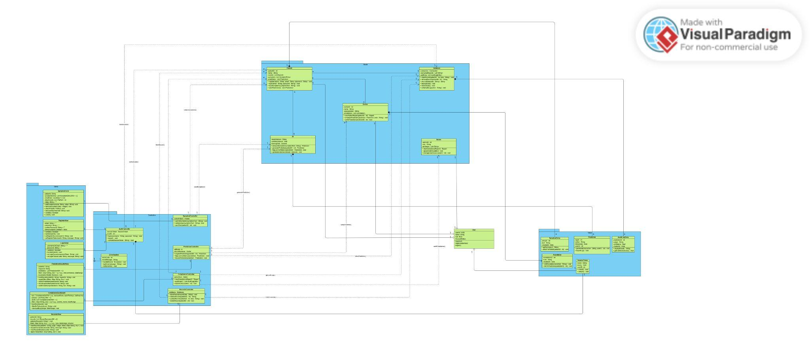
UPDATED CLASS DIAGRAM
Refined Classes Overview
The class diagram includes key entities like Patient, Doctor, Al, Database, System, and Admin.
Controllers and Value Objects
Controllers and value objects are incorporated to manage business logic and data encapsulation effectively.
Design Principles Applied
The design follows GRASP and MVC principles to separate concerns and improve traceability.
Notes:
The initial class diagram featured a basic structure with abstract user classes and limited relationships. It provided a starting point for modeling system entities but lacked detailed controllers and value objects necessary for implementing design patterns.

Slide 5

MOVING TO LIVE DEMO​
Feature Demonstration​
Doctor Annotation Workflow​
Unit Test Execution​
Notes:
CarePath successfully addresses the need for early disease detection through AI-assisted predictions while ensuring security and compliance. Its modular architecture, refined design, and adherence to best practices make it a reliable solution for modern healthcare challenges.

